Slide 1
An Examination of the Impact of
Institutional and Faculty Emphasis on Students’ Civic Engagement and Civic Outcomes
Jaclyn K. Rivard

Slide 2
Presentation Access
  Jaclynrivard.com/defense

Slide 3
Introduction
  Civic Engagement
  University context examples
    Participation in service-learning courses
    Attending civic events
    Engaging in on-campus or community political activity (voting, campaigning, etc.)
    Issues engagement– personal, engaging others, organizing others

Slide 4
Introduction
  Civic engagement means working to make a difference in the civic life of our communities and developing the combination of knowledge, skills, values and motivation to make that difference. It means promoting the quality of life in a community, through both political and non-political processes (Ehrlich, 2000, p. vi).

Slide 5
Research Questions
  To what extent is there a relationship between institutional and faculty emphases on students’ participation in civic engagement, and students’ civic engagement?
  To what extent is there a relationship between institutional and faculty emphases on students’ participation in civic engagement, and students’ civic outcomes?

Slide 6
Conceptual Framework
Figure 1: Conceptual Framework
Faculty Emphasis on Civic Engagement
Student Civic Engagement
Institutional Emphasis on Civic Engagement
Student Civic Outcomes
Student Characteristics

Slide 7
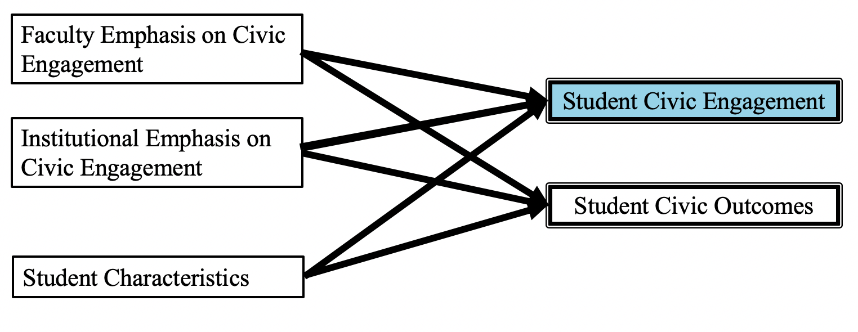
Student Civic Engagement
  Student participation in service-learning courses

Slide 8
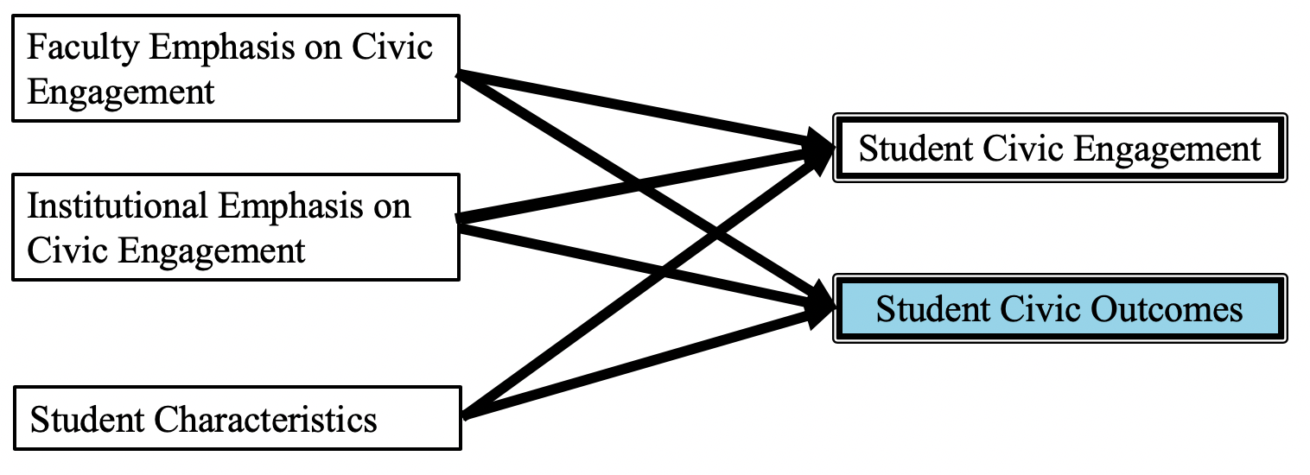
Student Civic Outcomes
  Student knowledge, skills, and development as an active and informed citizen

Slide 9
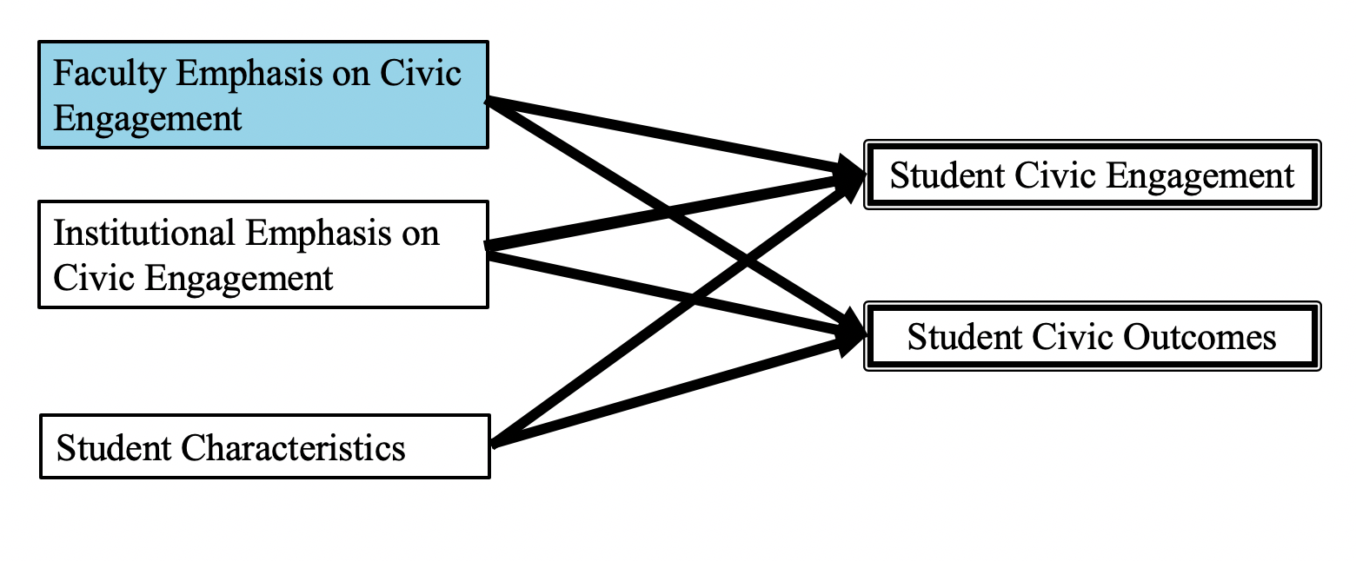
Faculty Emphasis on Civic Engagement
  Faculty use of service-learning
  Faculty emphasis or student report on using numerical information to examine a real-world problem or issue
  Faculty emphasis or student report on connecting learning to societal problems or issues
  Faculty encouragement of student civic engagement

Slide 10
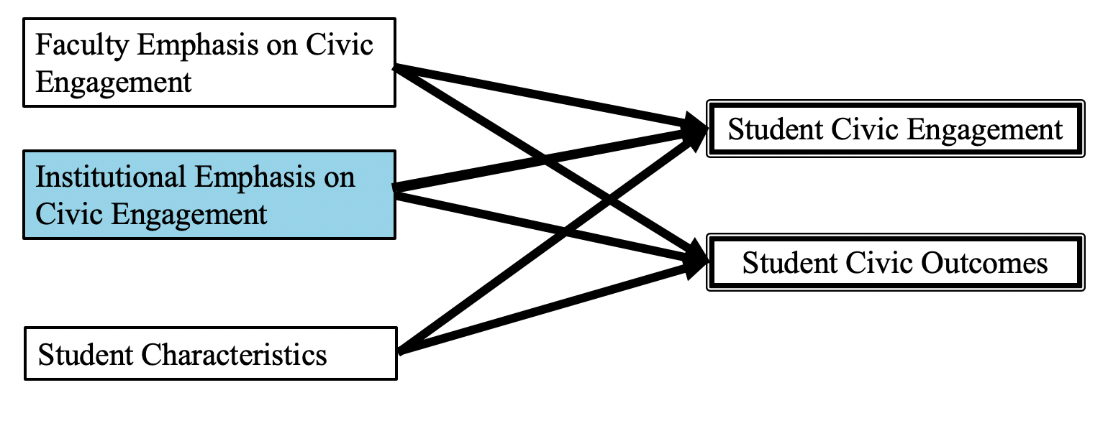
Institutional Emphasis on Civic Engagement
  Institutional Emphasis on Civic Engagement
    Helping people resolve their disagreements with each other
    Resolving conflicts that involve bias, discrimination, and prejudice
    Leading a group where people from different backgrounds feel welcomed and included
    Contributing to the well-being of their community
  Institutional emphasis on attending civic events

Slide 11
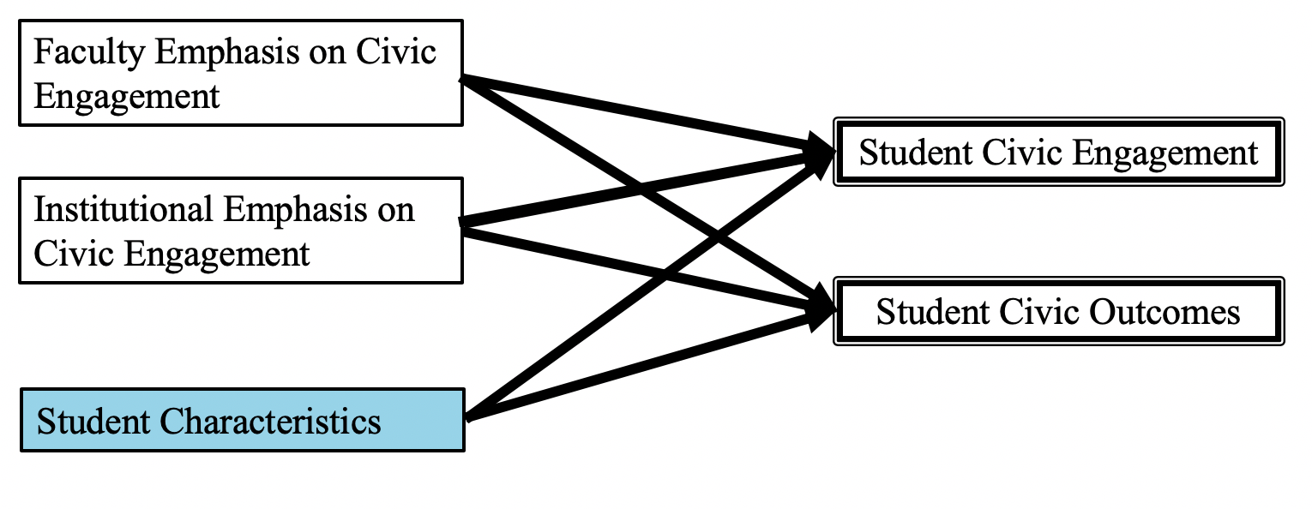
Student Characteristics
  Sex
  Race/Ethnicity
  First-generation status
  Living situation in college
  Disability Status
  Grades
  Weekly participation in co-curriculars
  Weekly volunteerism

Slide 12


Data & Instruments
  Instruments
    National Survey of Student Engagement (NSSE)
    Faculty Survey of Student Engagement(FSSE)
  Data
    Students who are seniors
    Faculty members and instructors
    267 Student Responses & 96 Faculty Responses
    Students matched to faculty by disciplinary group

Slide 13
Context
  Institution
    Small, private liberal arts college
    Demonstrated civic engagement focus
      Campus Compact
      Carnegie Community Engagement Classification

Slide 14
Statistical Analysis
  Disciplinary Groups
    STEM
    Arts and Humanities
    Social Sciences and Education
    Business and Communication
  Student Characteristics
  Civic Engagement & Civic Outcomes Variables
    Means & Standard Deviations
    Analyses of Variance (ANOVA)
    Regressions

Slide 15
Regressions: Civic Engagement
  Student participation in service-learning courses
    Weekly volunteerism
    **Faculty use of service-learning
    **Importance to faculty that students become active and informed citizens
    **Institutional emphasis on civic engagement
    **Faculty encouragement of student civic engagement
    ** variable included in only one regression model

Slide 16
Regressions: Civic Outcomes
  Student knowledge, skills, and development as active and informed citizens
    Male, Hispanic or Latino
    Connecting learning to societal problems or issues
    Using numerical information to examine real-world problems
    Institutional emphasis on attending civic events
    **Institutional emphasis on civic engagement
    ** variable included in only one regression model

Slide 17
Implications
  Implications for practice
    Attending Civic Events
    Institutional culture
    Faculty Development and Incentives
  Implications for research
    Closer examination of what institutional emphasis looks like.
    Inclusion of institutional emphasis as a critical variable in examining civic engagement and civic outcomes
    Conceptualizing participation in service-learning courses as an outcome
    Overcoming inequities

Slide 18
Conclusion
  Institutional and faculty emphasis on student civic engagement critically influence student civic engagement and student civic outcomes.

Slide 19
Thank you for coming!
Jaclyn K. Rivard rivar100@umn.edu http://jaclynrivard.com

